Slide 1
To express order use Ordinal Numbers :

Slide 2

st
First

Slide 3
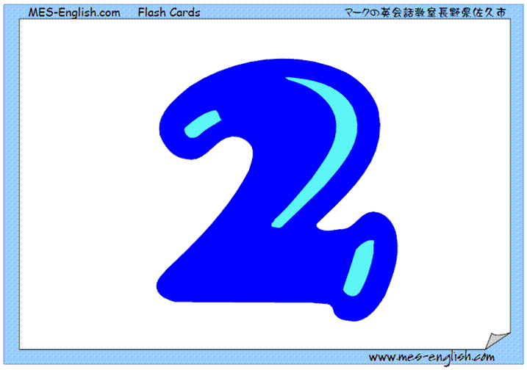
nd
Sencond

Slide 4
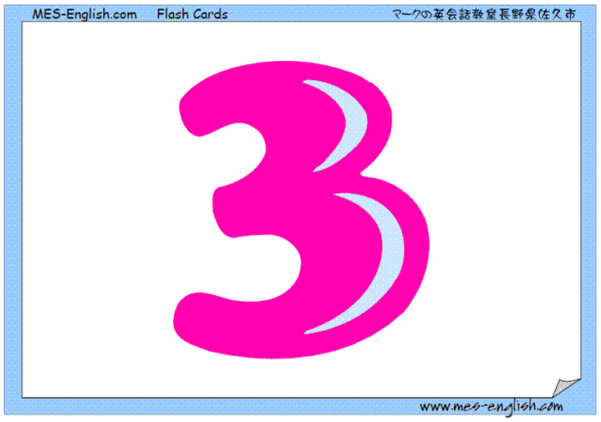
rd
Third

Slide 5
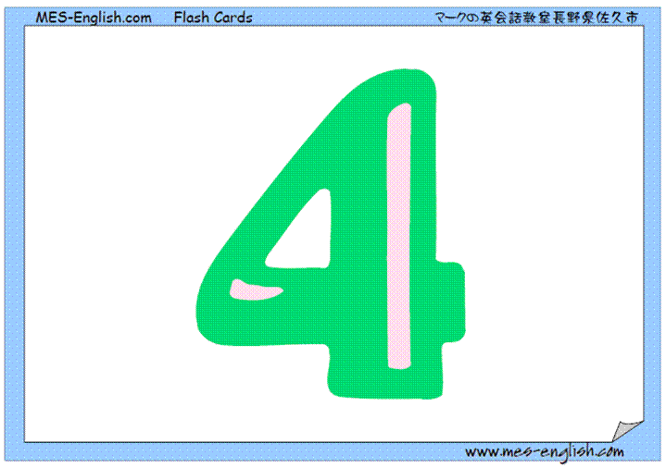
th
Fourth

Slide 6
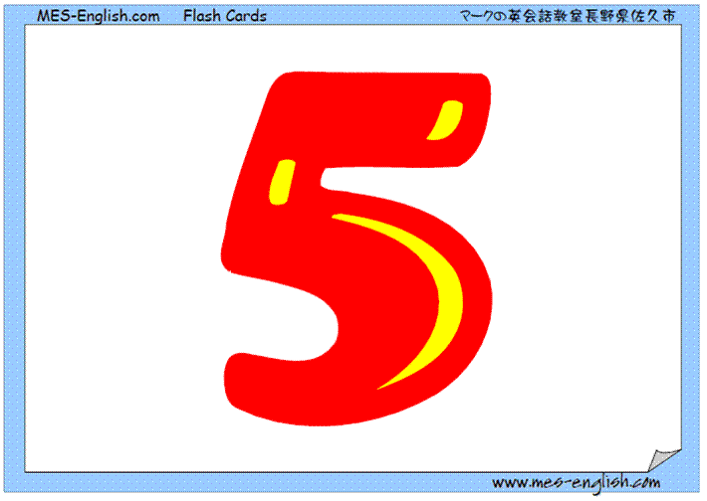
th
Fifth

Slide 7
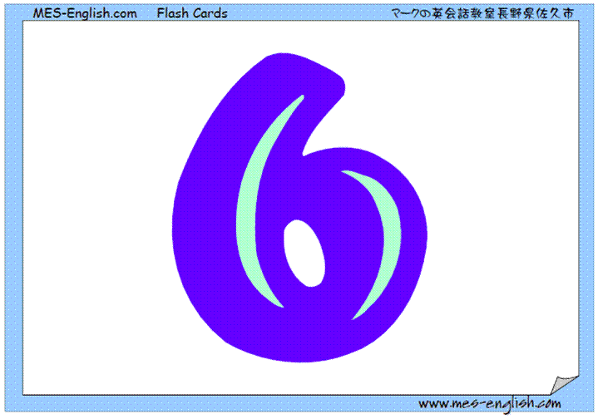
th
Sixth

Slide 8
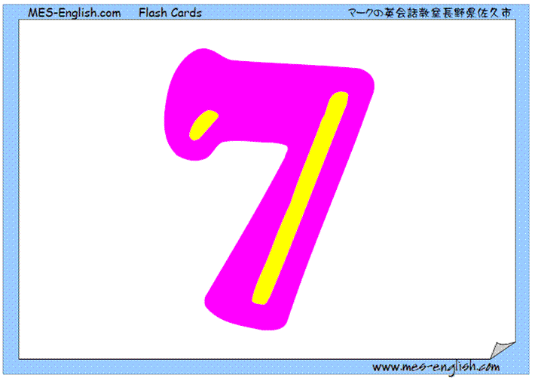
th
Seventh

Slide 9
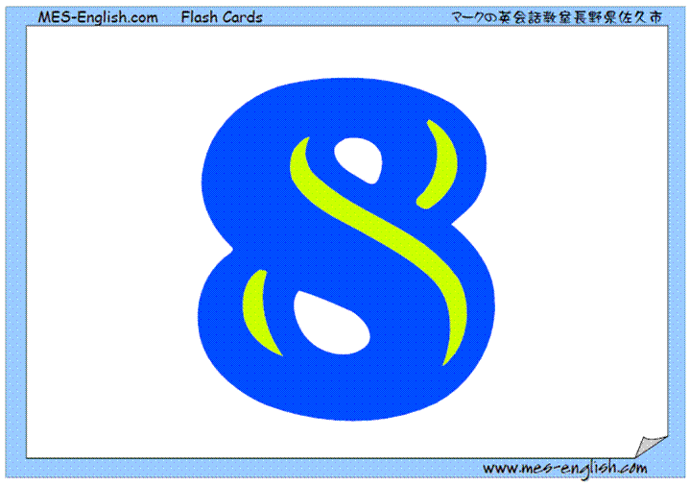
th
Eighth

Slide 10

th
Ninth

Slide 11

th
Tenth

Slide 12
th
Eleventh

Slide 13
th
twelfth

Slide 14
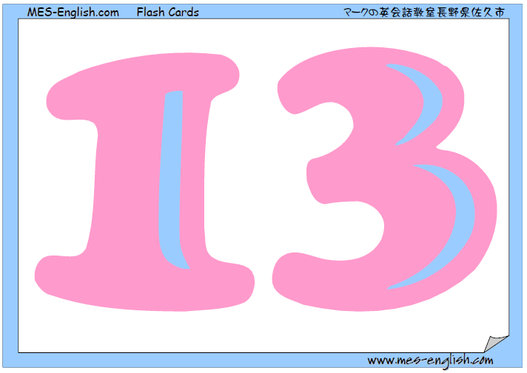
th
thirteenth

Slide 15
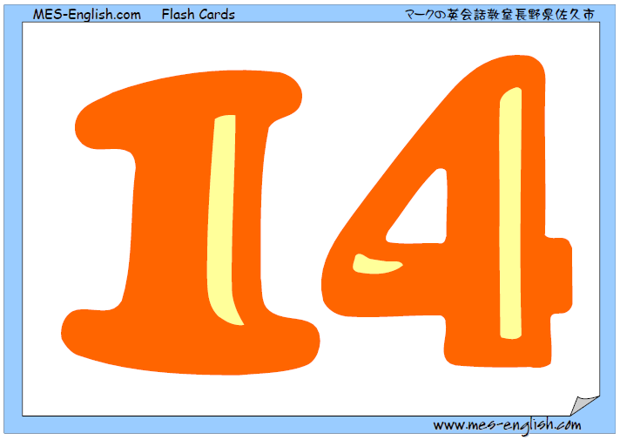
th
fourteenth

Slide 16
th
fifteenth

Slide 17
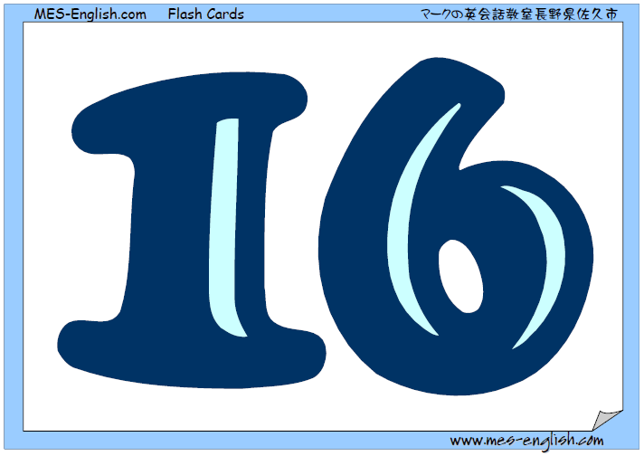
th
sixteenth

Slide 18
th
seventeenth

Slide 19
th
eighteenth

Slide 20
th
nineteenth

Slide 21
th
twentieth

Slide 22

st
Twenty-first

Slide 23
nd
Twenty-second

Slide 24
rd
Twenty-third

Slide 25
th
Twenty-fourth

Slide 26
th
Twenty-fifth

Slide 27
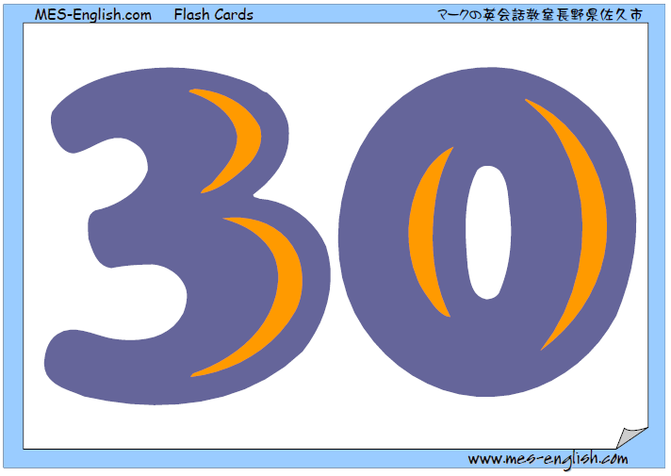
th
thirtieth

Slide 28
th
fortieth

Slide 29
th
fiftieth

Slide 30
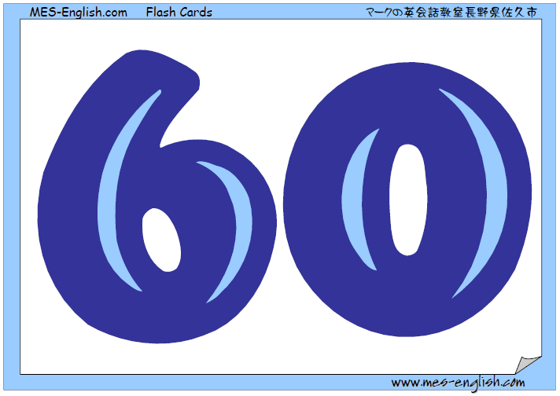
th
sixtieth

Slide 31
th
seventieth

Slide 32

eightieth

Slide 33

th
ninetieth

Slide 34
th
one hundredth

